Slide 1
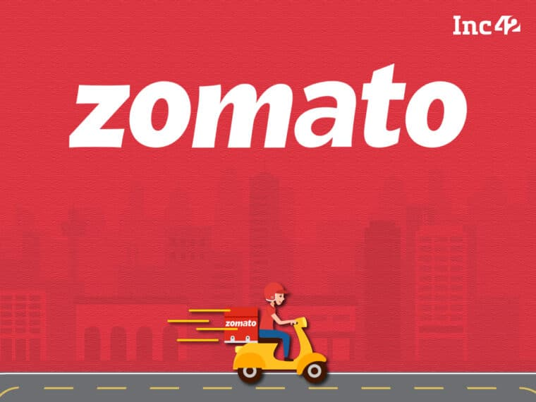
Restaurant Analysis
By DHANUSH S

Slide 2
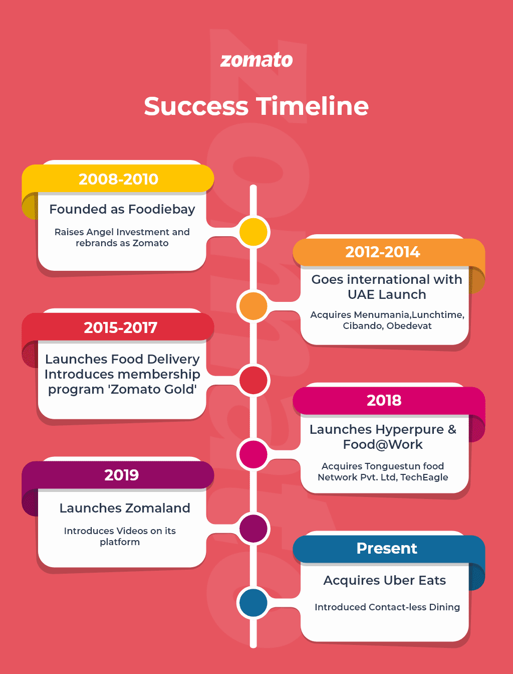
Project Objective:
As a data analyst consultant hired by Zomato, your responsibility is to develop strategies for expanding and opening new restaurants.
Zomato, an online platform established in 2008 in Delhi, India, provides users with restaurant reviews, menus, and food delivery services. The company's mission is to enhance dining experiences by guiding people to the best places to eat, ensuring they never have a poor meal. Zomato operates in over 23 countries, and its vision is to help users discover great dining spots globally. Revenue is generated through advertising partnerships with restaurants and its food delivery offerings. You are expected to analyze relevant data and provide insights for Zomato’s restaurant expansion efforts.

Slide 3
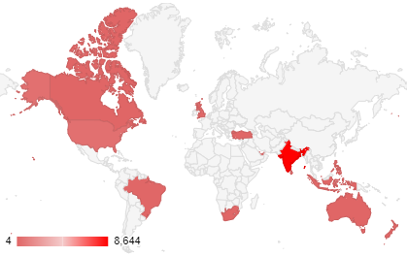
Zomato Data Overview:
The dataset contains 26 columns, labeled A to Z, providing comprehensive information about restaurants, including their name, opening date, cuisine type, rating, location (latitude and longitude), online delivery and table booking status, among other details.
Total Restaurants: 9,551
Total Countries: 15
Total Cuisines: 1,826
Total Cities: 141
This dataset offers valuable insights into Zomato's trends and customer behavior, enabling detailed analysis.
Data Cleaning and Processing
Standardized city and country names for accurate location analysis.
Reformatted the Date column for consistency and precision.
Filled missing "average cost for two" values using the mode per country and "cuisines" with the most popular cuisine per country.

Slide 4
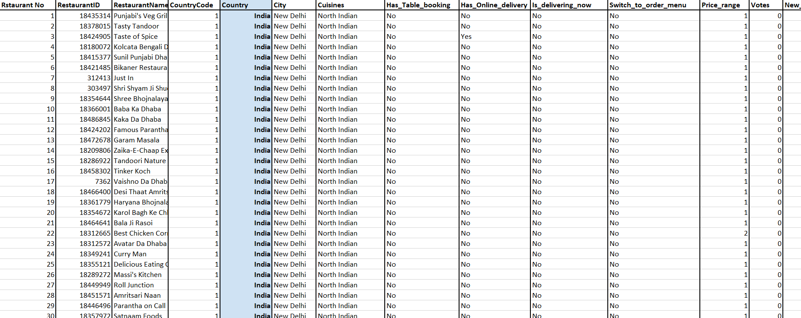
Feature Creation
Created a new column combining currency symbols with "average cost for two" using IF and CONCAT formulas.
Extracted the year from the date column for year-based slicer analysis.
Analysis and Recommendations
Used pivot tables to assess restaurant counts, ratings, and voter engagement across countries.
Recommended expanding into India due to low competition and favorable ratings.
Data Visualizations
Restaurant Count by Country and Year: Showed growth trends across years.
Price Range Distribution: Displayed affordability and market segmentation.
Average Votes per Country: Highlighted customer engagement levels per country.

Slide 5
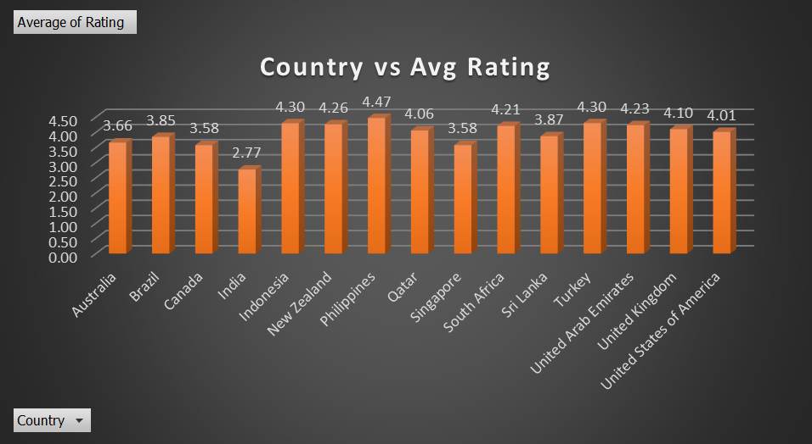
Major Findings
Despite being an Indian-based company catering primarily to an Indian audience, India has the lowest average restaurant rating of 2.8, compared to other countries. In contrast, the Philippines leads with an impressive average rating of 4.5.
This lower average rating for Indian restaurants doesn’t necessarily reflect poor quality. Instead, it could be attributed to the dataset's heavy representation of Indian restaurants. As the dataset size increases, the average rating tends to decrease due to a larger sample size.

Slide 6
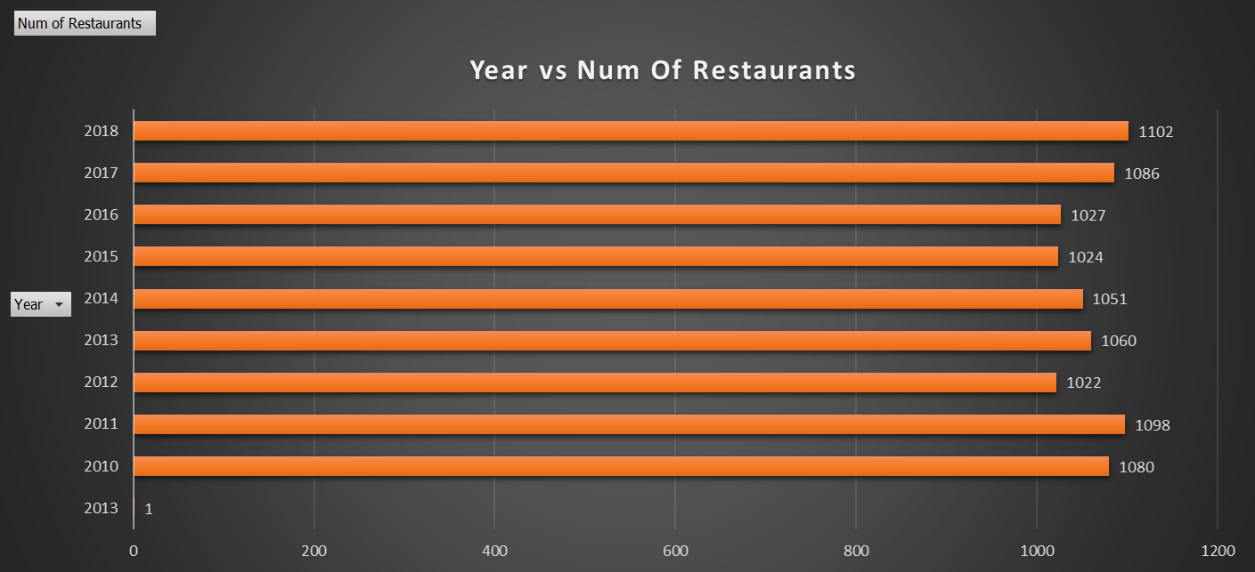
There is a clear trend indicating that higher average prices for two at a restaurant are often associated with higher ratings.
This correlation could be linked to factors such as better ambience, faster service, superior food quality, and the prestige tied to higher-priced dining experiences.
Another significant observation highlighting the company's growth and stability is the steady registration of approximately 1,000 restaurants per year on Zomato between 2010 and 2018.

Slide 7
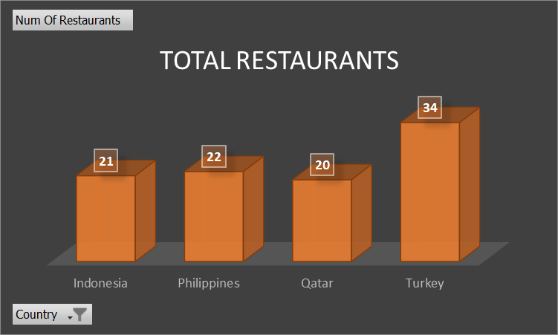
Insights
Proposed Expansion Plan
Based on the analysis, the selected countries for opening new restaurants are Indonesia, Philippines, Qatar, and Turkey.
Indonesia: With its tropical climate and rich natural resources like coconut groves, paddy fields, and seafood, Indonesia provides a diverse culinary base and a growing market for food enthusiasts.
Philippines: Known for its high average restaurant ratings (4.5), the Philippines presents a well-established food culture and a market appreciative of quality dining experiences.
Qatar: A country with a thriving economy and a preference for premium dining, Qatar offers immense potential for capturing high-value customers.
Turkey: With its unique blend of Eastern and Western cuisine, Turkey is a hotspot for gastronomic tourism, making it a promising market for new ventures.
These countries demonstrate strong potential for growth, aligning well with Zomato’s strategic objectives.

Slide 8
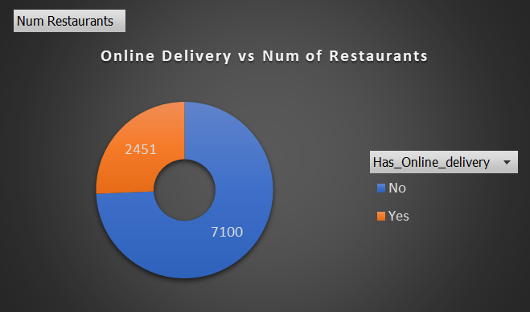
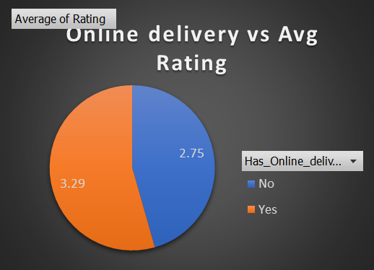
Creating a pivot table with "Online Delivery" in the rows and average ratings in the columns enables a direct comparison of ratings between restaurants that offer delivery and those that do not.
Additionally, analyzing the impact of table booking on customer ratings involves comparing the average ratings of restaurants that provide table booking services.
The graph illustrates the number of restaurants that offer online delivery services.
The findings suggest that to achieve higher customer ratings, restaurants should consider offering both online delivery and table booking options.

Slide 9
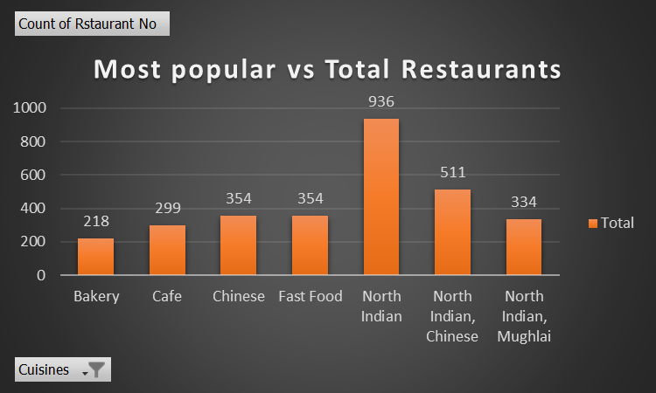
Strategic Recommendations
Expand Online Delivery Services: Increase the availability of online delivery to capture a larger market share, as currently, only 25% of restaurants provide this service.
Prioritize Popular Cuisines: Emphasize North Indian dishes to cater to local preferences and align with customer tastes.

Slide 10
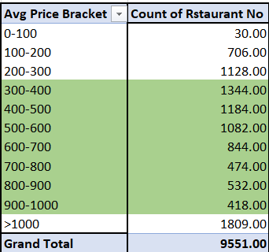
3. Strengthen Presence in Underrepresented Regions: Develop targeted marketing strategies to improve visibility in countries with growth potential. These regions, characterized by expanding middle-class populations and robust markets, offer significant opportunities for expansion. Currently, India accounts for 8,652 out of 9,551 restaurants, underscoring the need to diversify and open new establishments internationally.
These countries present viable opportunities for expansion, each featuring a growing middle-class population and a robust market. Currently, Zomato has a strong presence in India, with 8,652 out of 9,551 restaurants located there, which highlights the urgent need for new restaurant openings in other regions to diversify and tap into emerging markets.
4.Focus on Mid-Range Pricing:
Tailor your menus and promotions to target the ₹251-500 price range to boost appeal. Out of a total of 9,551 restaurants, 5,951 fall into the mid-range category, which includes restaurants with prices between ₹350–500 and ₹500–1,000. This shows that mid-range establishments make up more than half of the market. Therefore, it's crucial to adjust menus and pricing strategies to specifically cater to this segment.

Slide 11
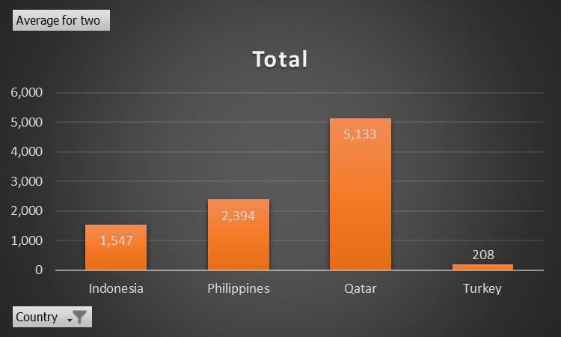
Expenditure Analysis
Qatar stands out with the highest average expenditure, reaching ₹5133 for two people.
Philippines stands 2nd with ₹2394 for two people.
Indonesia stands 3rd with ₹1547 for two people.
Turkey stands last with ₹208 for two people.
Key Insights and Recommendations
High Expenditure in Qatar: Qatar's high average expenditure suggests a market willing to pay a premium for dining experiences.
Opportunity: Consider introducing premium services or upscale dining options to target the high-spending segment.
Strategies: Expand luxury offerings, offer exclusive deals, or introduce high-end dining experiences to appeal to the higher-expenditure market.

Slide 12
2. Moderate Expenditure in the Philippines: The Philippines' expenditure of ₹2,394 indicates a balanced market with moderate spending.
Opportunity: Offer premium yet affordable dining experiences that cater to this middle-income segment.
Strategies: Introduce value-focused options like set meals, combos, or family packages to attract customers in this price range.
3. Moderate Expenditure in Indonesia: Indonesia’s average expenditure of ₹1,547 suggests an emerging middle-class market.
Opportunity: Create affordable and attractive dining options to appeal to price-conscious consumers while still maintaining quality.
Strategies: Implement promotions, discounts, or region-specific menu options to engage this growing segment.
4. Low Expenditure in Turkey: Turkey’s significantly lower average expenditure of ₹208 indicates a highly cost-conscious market.
Opportunity: Focus on affordable, value-driven offerings to attract budget-conscious diners.
Strategies: Roll out budget-friendly menu options, discounts, and special promotions to increase restaurant traffic and boost overall expenditure.

Slide 13
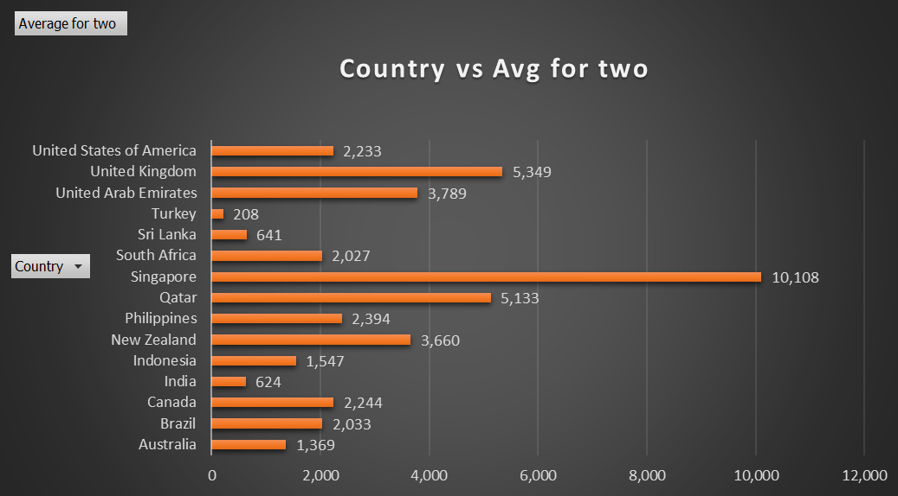
5. Localized Marketing Strategies: Tailor marketing efforts based on regional spending behaviors:
In high-expenditure markets like Qatar, emphasize luxury, exclusivity, and premium offerings.
In lower-expenditure markets like Turkey, focus on affordability, value propositions, and cost-effective dining options to attract a broader audience.
By customizing marketing and restaurant offerings based on local expenditure patterns, Zomato can better cater to the needs and preferences of customers in each region, enhancing both customer engagement and revenue.

Slide 14
Strategic Recommendations for Selected Countries
Enhance Customer Experience in Indonesia: Improve service quality through partnerships and training.
Target High-Expenditure Markets (Qatar & Philippines): Introduce premium dining and exclusive deals.
Affordable Options in Low-Expenditure Markets (Turkey & Indonesia): Focus on budget-friendly menus and discounts.
Localized Marketing: Tailor efforts based on regional spending habits.
Diverse Cuisine Offerings: Introduce popular and trendy cuisines like Italian, Japanese, and plant-based options.
Quality Control & Training: Improve quality control for underperforming dishes.
Revamp Low-Performing Dishes: Regularly adjust or remove poorly-rated menu items.
Balanced Pricing Strategy: Offer affordable options in high-end markets and premium experiences in value-driven markets.
Leverage Delivery & Booking Options: Highlight online delivery and table booking for added convenience.

Slide 15
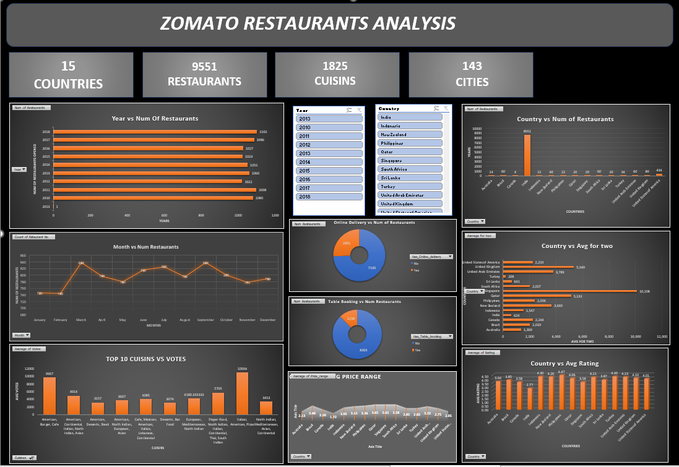

Slide 16
Conclusion
Market Opportunities & Competition: Lower-priced restaurants dominate the market, indicating high competition in budget-friendly segments, while fewer high-end establishments present growth opportunities in the premium market. Services like online delivery and table booking can enhance customer ratings and offer a competitive advantage.
Customer Preferences: Higher-priced restaurants receive better ratings, aligning with customer expectations of quality. Popular cuisines like Sunda, Sushi, and Café-style dining offer potential for growth. Focusing on quality improvements and customer feedback can boost satisfaction.
Geographical Trends: Underserved regions, especially in emerging markets and high-demand cities, present expansion opportunities. Offering services like online delivery in these areas can strengthen market presence.
Strategic Recommendations: Focus on high-quality offerings in popular cuisines, implement pricing strategies that reflect value, expand delivery and booking services, and target emerging markets with growth potential.

Slide 17
Thank you

